Slide 1
Hand-free Controller FOR VR Applications
Team: Untitled

Slide 2
THEMATIC MOTIVATION
Augmented reality-Virtual Reality (AR-VR) is a new domain that can open new opportunities and use cases
The rapid development of supporting technology
IoT: smart sensors
5G: Increased connectivity and reduce latency
Efficient chip: Increase computation in small footprint
AI: Utilise data to unlock new functionalities
Smart nation requires 2 approaches
Top-down: New opportunities from tech available only to government and companies
Manufacturing robots, 5G infrastructure
Bottom-up: New opportunities from the wide adoption of consumer electronics
PayLah, Singpass works when people have smartphones

Slide 3
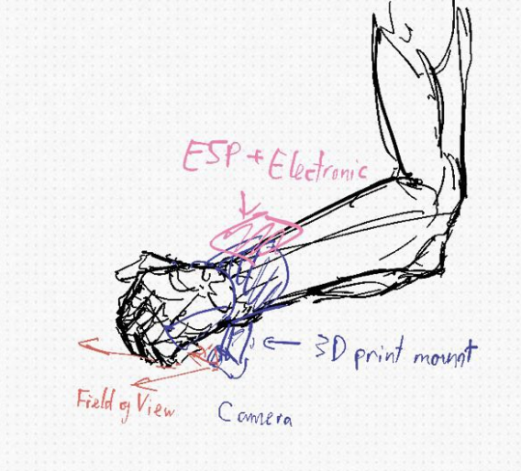
IDEATION
The traditional controller can be troublesome because it requires constant grip from the user
Strain and limited interaction within VR environment
Better kind of controller will induce the bottom-up adoption and unlock new types of interaction
We plan to hack a hand-free solution to VR Controller

Slide 4
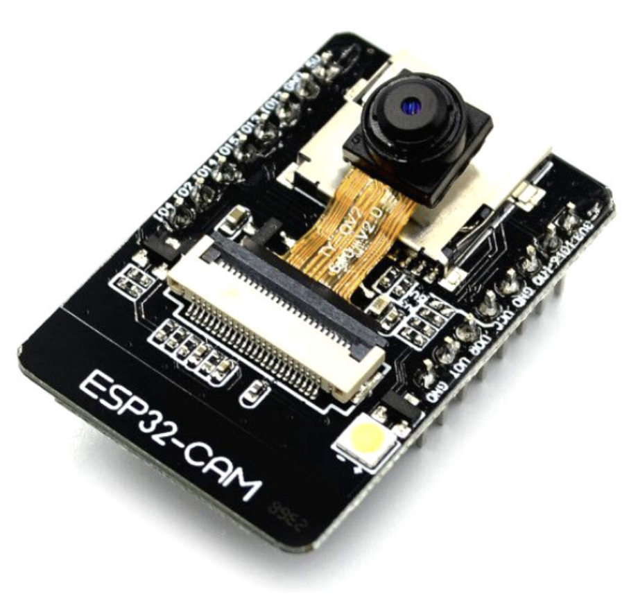
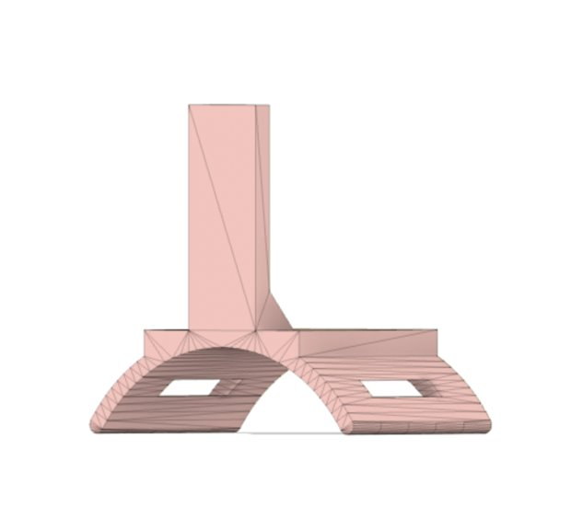
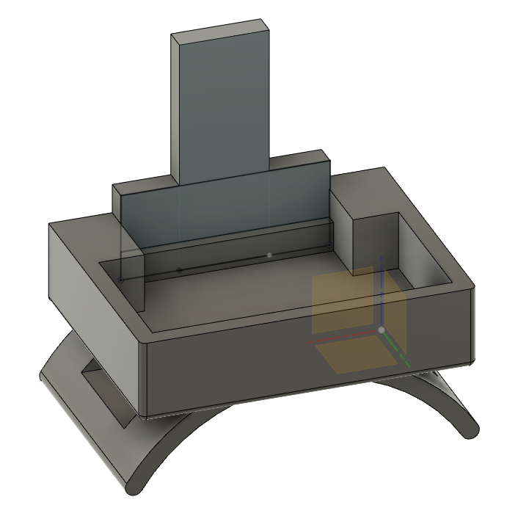
COMPONENTS
Hardware:
ESP32-CAM
3D Printed mount
Software:
Python
Mediapipe ML Library
Blender (Mo Cap plugin)

Slide 5
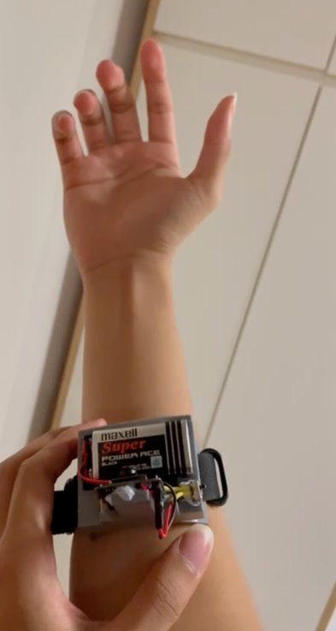

INTEGRATION
Capture image
Mediapipe:
Hand pose detection
MoCap Plugin:
Landmark to keyframe
ESP-CAM
(server)
Python
Blender
Request image
Same network
Same network
Phone hotspot

Slide 6
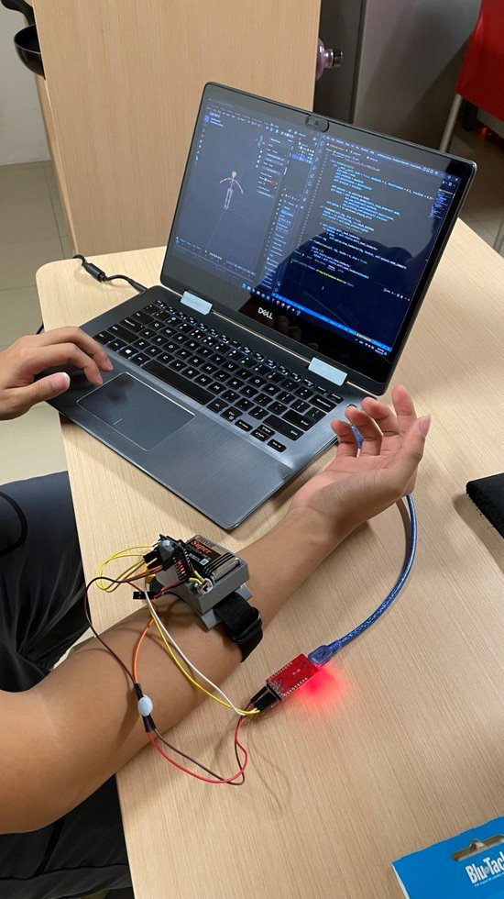

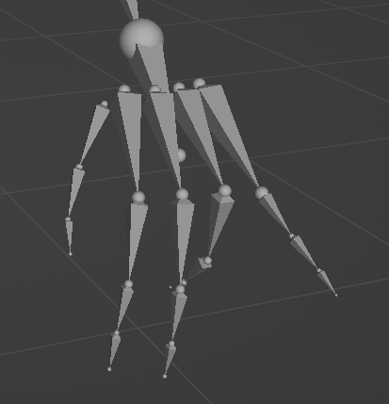
VISUALISATION
To demonstrate the idea of applying it to VR application, we use the 3D modelling program Blender to try and map the hand keypoints to a hand rig
Wired development
Wireless deployment

Slide 7
FUTURE DEVELOPEMENT
The unusual angle makes it difficult for the model to predict well
In the future given more time and resources, we plan to refine the model by retraining with data specifically from the wrist point of view
Additionally, every step of the integration process can be improved
Low power, IoT wearables with rechargeable battery
Live streaming process
Keypoint to 3D visualization/description that is compatible with VR SDK
Additional hardware that help in odometry, localisation

Slide 8
Thank you For Organizing the Hackathon
Slides template by: Slidesgo

